Slide 1
Energy Partitioning and Particle Acceleration at the Bow Shock of Saturn
Jamesen Reese
The University of Arizona
Arizona Space Grant Consortium
April 22nd 2023
Mentored by Federico Fraschetti

Slide 2
Interplanetary Bow Shocks
Bow shock forms when blunt object interrupts flow of viscous medium at supersonic speeds
Sudden change in pressure, density, and temperature of medium at shock
Flow of charged plasmas in space encounter magnetic field bubble (magnetosphere) of planets
Saturn’s bow shock is stationary
Infrared imaging of plasma encountering the magnetosphere of star Kappa Cassiopeiae.
Source: NASA Spitzer Space Telescope

Slide 3
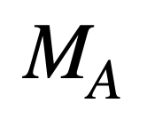
Saturn
Shocks are characterized by Alfvén Mach numbers MA
“Alfvén Mach numbers” - the speed of plasma flow divided by the speed of transverse Alfvén waves which propagate through magnetic field lines
The bow shock of Saturn is a unique laboratory
The solar wind fluid at Saturn’s position has high Alfvén Mach numbers (MA ~ 10-100) compared to that of Earth (MA ~ 4-8)
At 10 AU, the planet is within the range of spacecraft such as the Cassini Probe
Energetic ions from steady flow of thermal wind trapped at stationary bow shock
Study of the energy and acceleration of such particles will give insight to the nature and origin of cosmic-rays

Slide 4
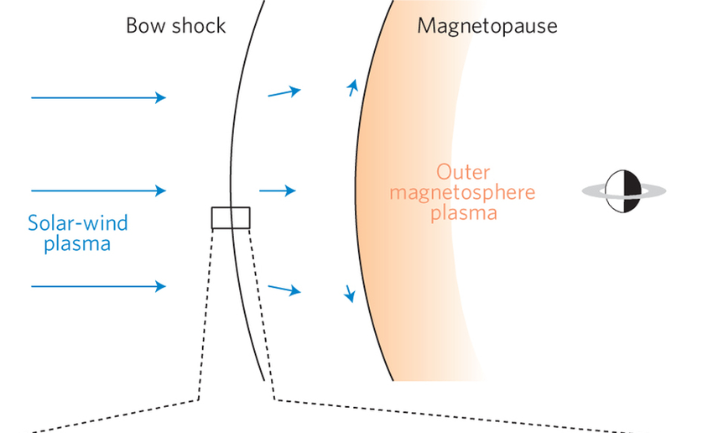
Methodology
Upstream
Downstream
The discontinuity jump conditions for magnetohydrodynamics state that mass, momentum, and energy of the plasma must be conserved across the shock.
The equations are written in the rest frame of the shock
In-situ measurements to analyze total energy of plasma before (upstream) and after (downstream) the shock
Total energies are made up by fractional energies
Plasma’s internal energy associated with heat (enthalpy), energy in magnetic field, and kinetic motion
Includes contributions from energetic ions downstream
Source: Masters, A. & Stawarz, L. & Fujimoto, M. & Schwartz, S. & Sergis, Nick & Thomsen, Michelle & Retinò, Alessandro & Hasegawa, Hiroshi & Lewis, G. & Coates, Andrew & Canu, P. & Dougherty, M.. (2013). Electron acceleration to relativistic energies at a strong
quasi-parallel shock wave. Nature Physics. 9. 10.1038/nphys2541.

Slide 5
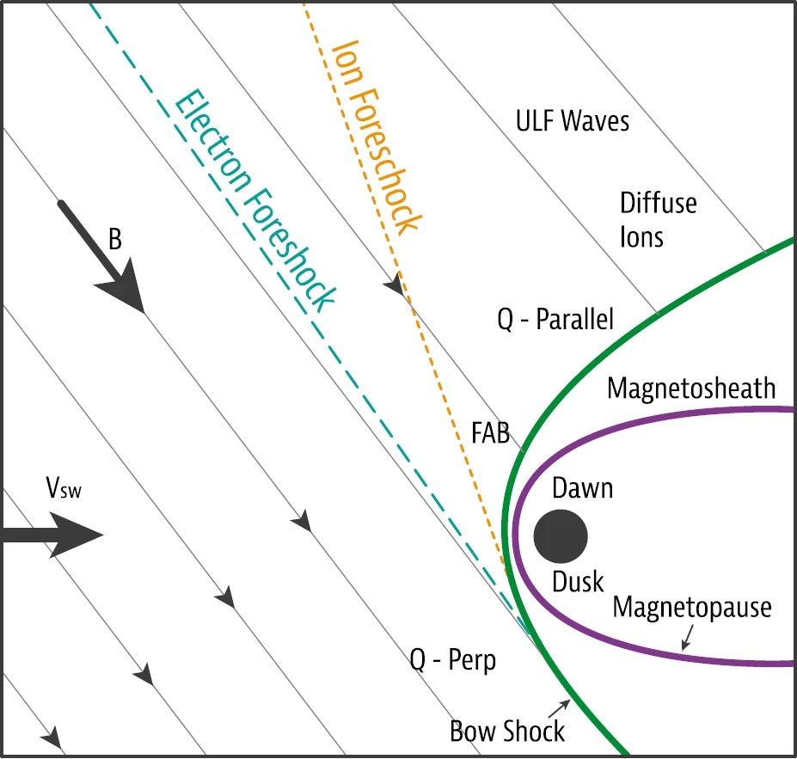
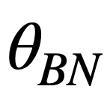
Data Selection
The angle between the magnetic field and shock normal vector BN characterizes bow shocks
BN > 45° “quasi-perpendicular”
BN < 45° “quasi-parallel
Data taken from the Cassini Plasma Spectrometer (CAPS), Cosmic Dust Analyzer (CDA), and Magnetospheric Imaging Instrument (MIMI) measurements
463 shocks from 2007-2012 that varied in Alfvén number and BN
B
Normal
Source: X. Blanco-Cano, Bow shocks in the solar wind: lessons towards understanding interplanetary shocks. AIP Conf. Proc. 1216(1), 459–465 (2010). https://doi.org/10.1063/1.3395903

Slide 6
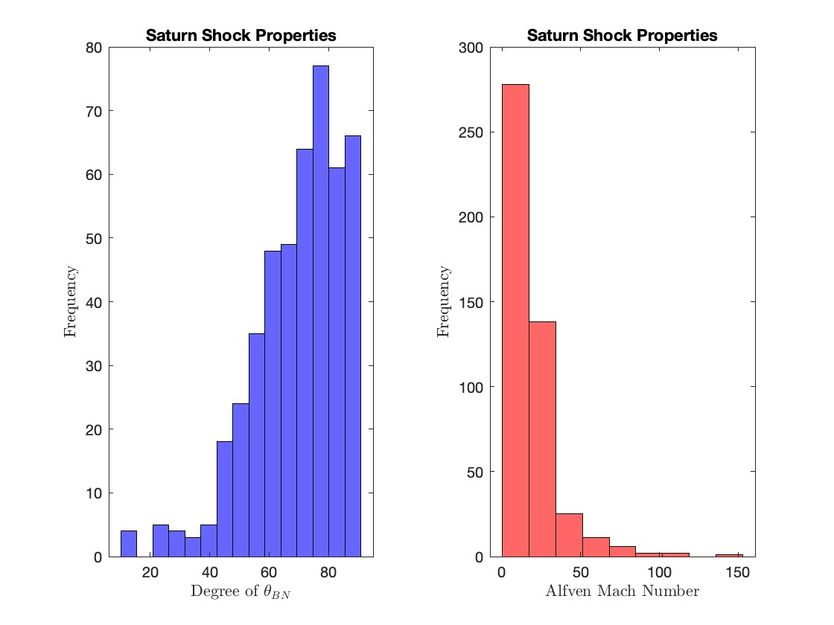

Slide 7
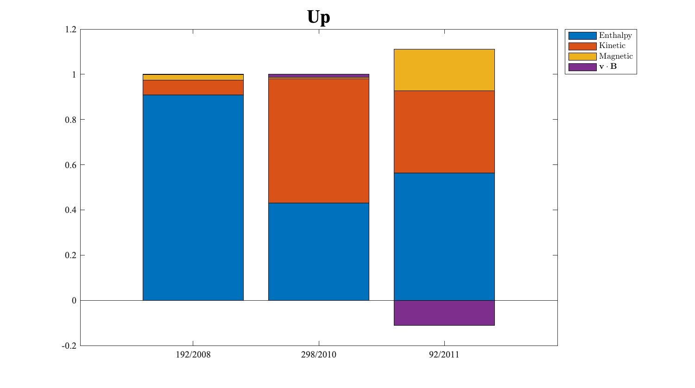
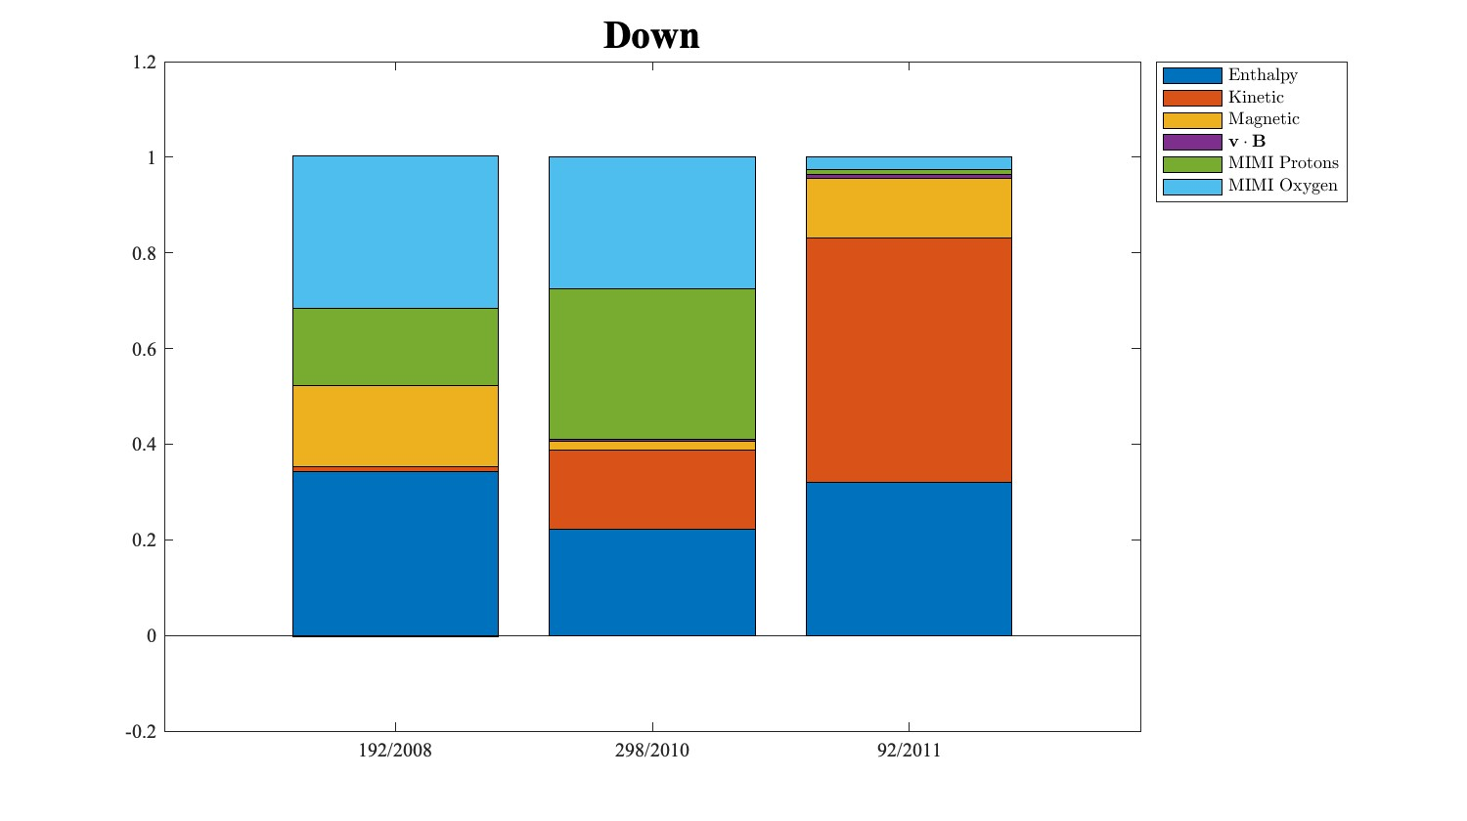
Upstream/Downstream Energy
Inflated upstream enthalpy due to insufficient time resolution of data, Cassini not designed for this scope

Slide 8
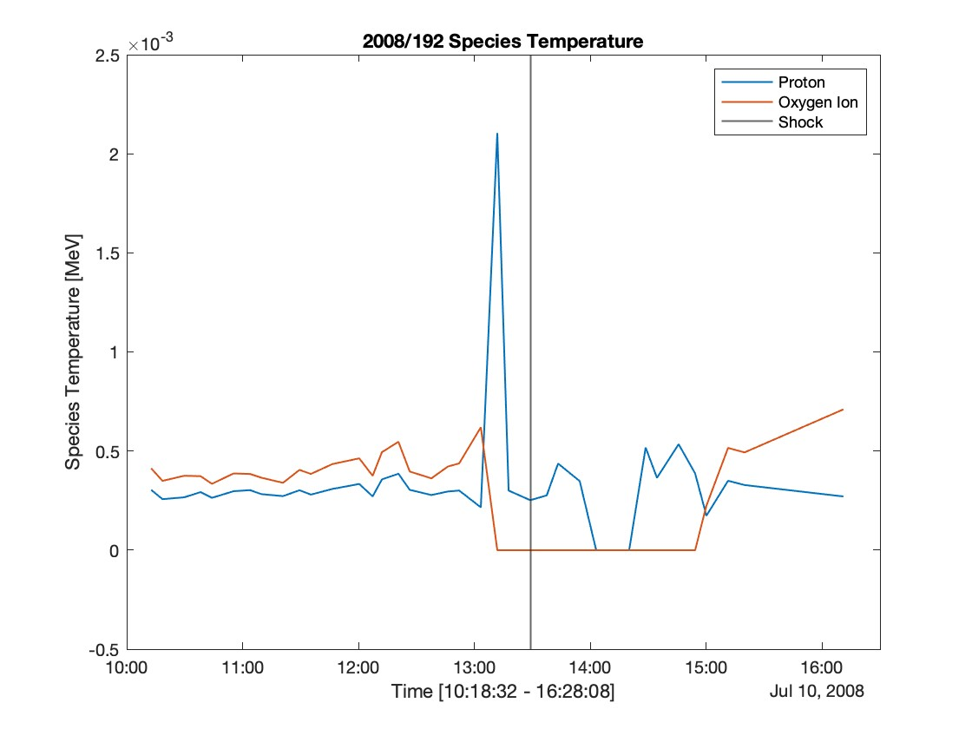
July 10th 2008
Downstream
Shock has an Alfvén Mach number of 87 and field-normal angle of 62°
Enthalpy and energetic particle density are in competition
Proton temperature higher than oxygen ion suggests more energetic oxygen ions
Oxygen ions make up over >30% of downstream energy, total ions >50%
Upstream

Slide 9
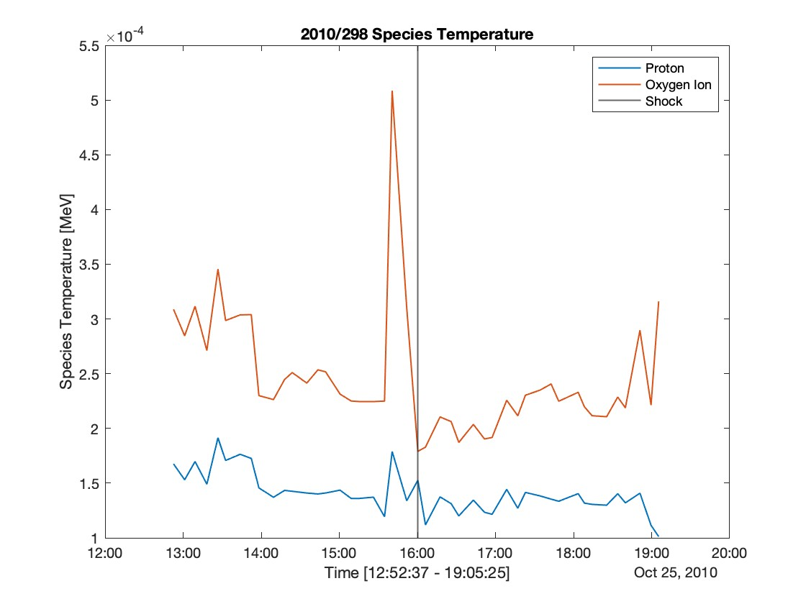
September 25th 2010
Downstream
Shock has an Alfvén Mach number of 27 and field-normal angle of 15°
Kinetic energy drained from the shock into high oxygen temperature
Bar graph agrees, shows more energetic protons
Contribution from both ~60% of total energy
Upstream

Slide 10
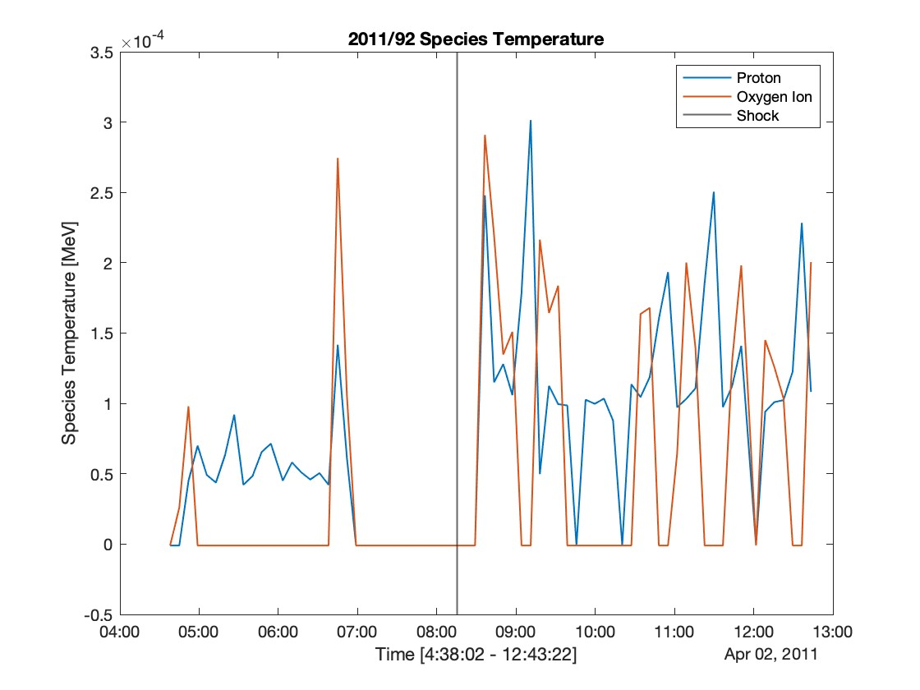
April 2nd 2011
Downstream
Upstream
Magnetic field profile is neat, ion temperature profile is messy
Difficult to conclude nature of ion acceleration
This sock profile is similar to the majority of our data, inconclusive

Slide 11
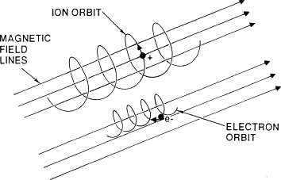
Ions from the Magnetosphere?
Saturn’s magnetosphere may be accelerating the ions
Investigate this by particle motion through gyro-radius
“Gyro-radius” - the radius of the orbit of charged particles around a magnetic field
Given by $|r|=\frac{mγ|v_{⊥}|}{|q||B|}$
Source: M.R. Gordinier, Encyclopedia of Physical Science and Technology (Third Edition)

Slide 12
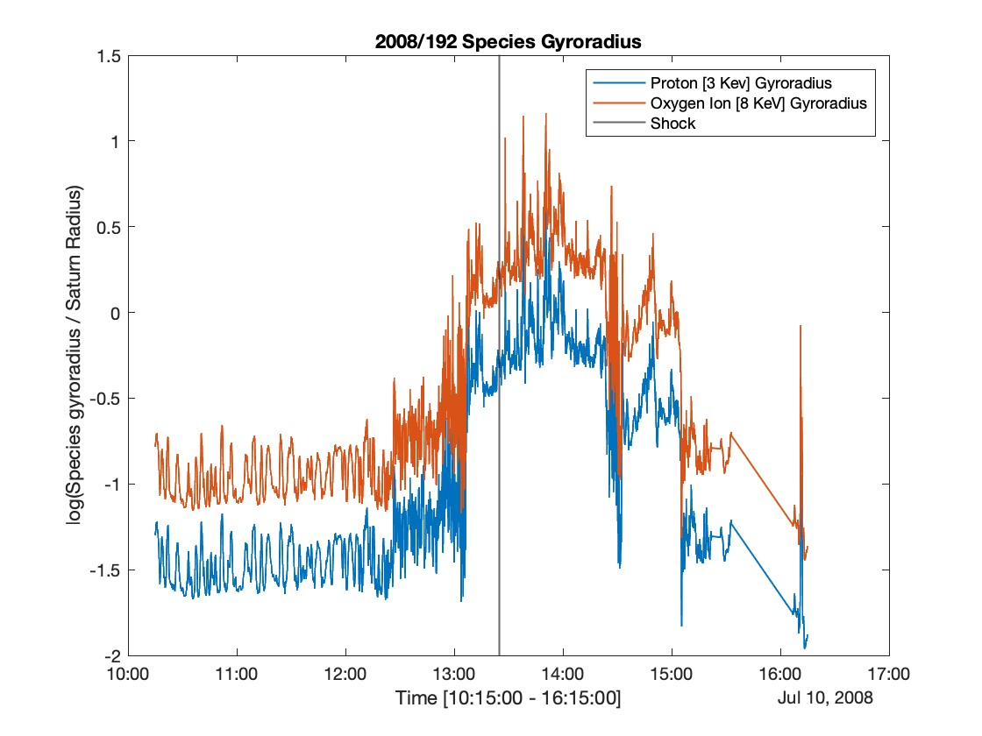
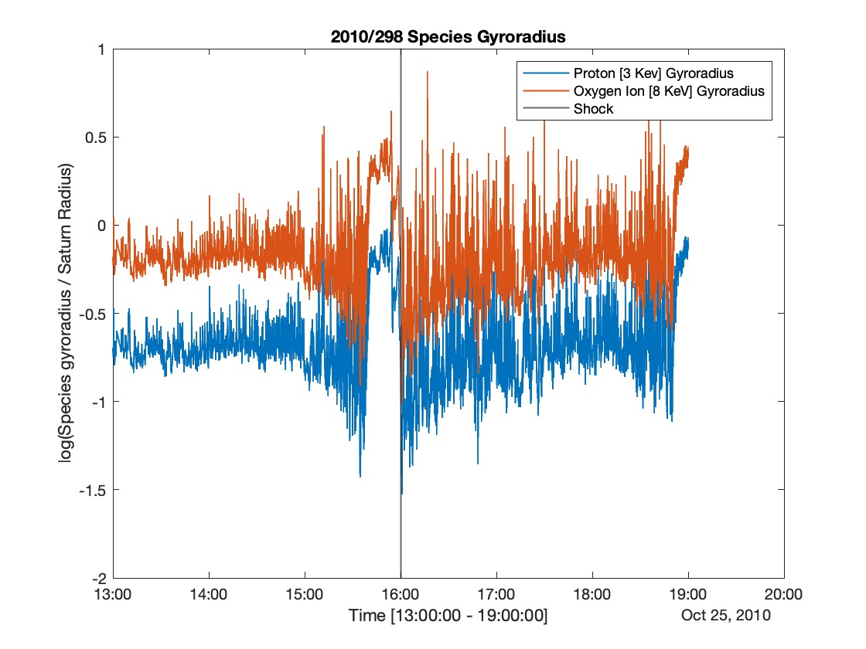
Downstream
Downstream
Upstream
Upstream
Gyration of all ions is much smaller than the Saturn radius, which is much smaller than bow shock radius.
Does not exceed bounds of shock surface, ions not accelerated by the magnetosphere but by the shock.

Slide 13
Conclusions
Ion temperature spikes yet doesn’t stay large for long
Shock surface dissipates the plasma body’s kinetic energy into heat and high ion temperatures
As temperature dissipates, energy transfer accelerates the plasma’s charged particles
On 192/2008 and 298/2010 charged protons and oxygen ions made up over 50% of the total downstream energy in both cases while having a a difference in BN of 45° (62° and 15°)
Compare this to Earth’s bow shock where ion acceleration makes up less than 20% of the total energy budget.
Higher energy fraction of ions downstream of Saturn’s bow shock than expected
Shows that a higher Alfvén Mach number ultimately increases the energy of charged energetic particles regardless of angle between magnetic field and shock normal. Still exploring ions of magnetospheric origin.
Used in situ measurements to disproves some numerical simulations that claim quasi-perpendicular shocks are inefficient in particle acceleration. Possible errors in ion energy arise from the poor data resolution.

Slide 14
A special thanks to
Dr. Federico Fraschetti, Department of Lunar and Planetary Sciences, University of Arizona
Liam David, Plasma Physics Laboratory, Princeton University
Michelle Coe and Dr. Chandra Holifield Collins, Arizona Space Grant Consortium
Harvard Center for Astrophysics
The University of Arizona
Arizona Space Grant Consortium
The National Aeronautics and Space Administration

Slide 15
Thank You.

